Slide 1




34. Vectors

Slide 2


Essential Question
What is a vector and how do you combine them?

Slide 3


Scalars
A scalar is a quantity that has magnitude only (no direction)
Examples of Scalar Quantities:
Distance
Area
Volume
Time
Mass

Slide 4
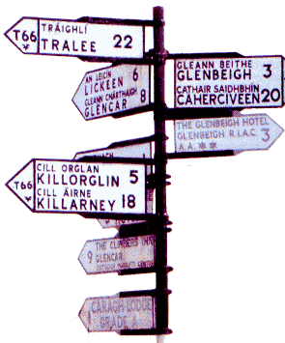
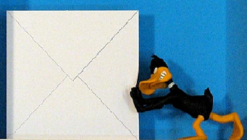
Vectors
A vector quantity is a quantity that has both magnitude and a direction in space
Examples of Vector Quantities:
Displacement
Velocity
Acceleration
Force

Slide 5
Why vectors?
Engineering – forces need to balance when constructing a bridge so that it doesn’t fall
Navigation – Wind or currents change the direction and speed of planes and boats

Slide 6
Notation
Vectors are written with a half arrow on top
or as a bold lowercase letter such as u, v, or w

Slide 7
4 ways to represent a vector
1. 2 points – initial point and terminal point
B
Terminal point (x₂, y₂)
A
Initial point (x₁, y₁)
The initial point is called the head and has no arrow
The terminal point is called the tail and has an arrow
showing direction

Slide 8


Example
Draw a vector with initial point (2, 3) and terminal point (-5, 7)

Slide 9
4 ways to represent a vector
2. Component form
Has < > around it (versus ( ) for points)
To find component form given 2 points:
terminal point minus initial point
< x₂-x₁ , y₂-y₁ >

Slide 10
Example
Find the component form a vector with initial point (-1, 5) and terminal point (9, -2)

Slide 11
4 ways to represent a vector
3. Linear combination
The letter i represents the x portion and
The letter j represents the y portion
It has no commas or brackets
(x₂-x₁)i + (y₂-y₁)j

Slide 12
Examples
Find the linear combination form a vector with initial point (2, 5) and terminal point (-3, -2)
Write in linear combination form <8, -3>

Slide 13
4 ways to represent a vector
4. Magnitude and direction
20 mph at 125º
40 N at 25º north of west

Slide 14
Direction
North = +
South = -
East = +
West = -
90 º North
y
+
-
+
0 º East
West 180 º
x
360 º
-
270 º South

Slide 15
MEASURING THE
SAME DIRECTION
IN DIFFERENT WAYS
90^{O} North
+y
120^{O}
-240^{O}
West 180^{O}
+x
0^{O} East
- x
360^{O}
30^{O} West of North
30^{O} Left of +y
60^{O} North of West
60^{O} Above - x
- y
270^{O} South

Slide 16
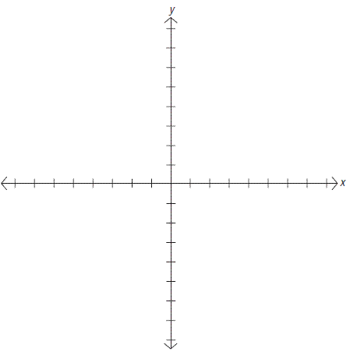
Examples
Draw a vector with magnitude of 20 ft at 185º
Draw a vector with magnitude 10 ft at 30º south of west
Draw a vector with magnitude 35 at 25º east of south

Slide 17
To find component form given magnitude and direction
Use trig!!
Each vector is made up of an x component and a y component
To find the x component, multiply the magnitude by cos θ
To find the y component, multiply the magnitude by sin θ
<Acosθ,Asinθ> or (Acosθ)i + (Asinθ)j
A
Asinθ
θ
Acosθ

Slide 18
Example
Find the component form of a vector with magnitude of 30 mph at 40º

Slide 19
Example
Find the component form of a vector with magnitude of 120 at 25º west of north

Slide 20
To find magnitude and direction given component form
Notation for magnitude is
If you know the x and y components, the magnitude can be found using the pythagorean theorem!!
Direction is found using trig!
y
θ
x

Slide 21
Where is the vector?
You need to figure out what quadrant a vector is in because your calculator only gives you answers in the 1st (positive) or 4th quadrant (negative)
If the vector is in the 1st quadrant, leave the answer your calculator gives you alone
If the vector is in the 2nd or 3rd quadrant, add 180 to your answer
If the vector is in the 4th quadrant, add 360 to your answer

Slide 22
Example – Find the magnitude and direction angle of
component form of
(-3,4)
P
The magnitude is
(-5,2)
Q
The direction is:
What quadrant is it in??
3rd (so we will add 180)

Slide 23
Example
The component form is
Find the direction, and magnitude if initial point is (1,11) and terminal point is (9,3)
The magnitude is
The direction is

Slide 24
Vector Operations
You can add and subtract vectors – this changes their magnitude and direction
The answer is called the resultant
To find the resultant, simply add or subtract the components
You can also multiply vectors by a scalar (a number) – this changes their magnitude but not their direction (if you multiply by negative, it reverse direction)
To multiply – distribute the number to both components

Slide 25
Adding Vectors Graphically
To add vectors graphically, position them so the initial
point of one is connects with the terminal point of the other, the
diagonal is the resultant vector
v
u+v
u + v is the resultant vector.
u

Slide 26
Example
v<-2,5> w<3,4>
Find v+w
v–w
2v
4u – 7v
algebraically and graphically

