Slide 1
19. Cofunction and even/odd identities

Slide 2
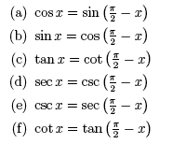
cofunction

Slide 3
Where do these come from?
Let’s look at a right triangle
SIN A = O/H = BC/AB
A
COS B = A/H = BC/AB
SIN A = COS B
Angle A = 90 – Angle B
SO SIN (90-B) = COS B
C
B

Slide 4
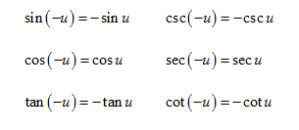
EVEN/ODD IDENTITIES

Slide 5
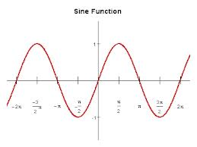
Where do these come from?
Let’s look at the graph of sin
Sin is an odd function
Pick an x value and find y
Now pick –x value and find y
Sin(-x) = -sin (x)

Slide 6
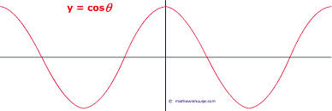
Where do these come from?
Let’s look at the graph of cos
Cos is an even function
Pick an x value and find y
Now pick –x value and find y
Cos(-x) = cos (x)

Slide 7
Example

Slide 8
example
Verify

