Slide 1
EOC Practice
Question of the Day

Slide 2
CCGPS Geometry Day 74 (11-11-14)
UNIT QUESTION: What connection does conditional probability have to independence?
Standard: MCC9-12.S.CP.1-7
Today’s Question:
What is the difference between the intersection and the union of 2 events?
Standard: MCC9-12.S.CP.1, 7

Slide 3
Mutually Exclusive VS. Overlapping

Slide 4
Compound Probability
A compound event combines two or more events, using the word and or the word or.

Slide 5
Mutually Exclusive vs. Overlapping
If two or more events cannot occur at the same time they are termed mutually exclusive.
They have no common outcomes.
Overlapping events have at least one common outcome.
Also known as inclusive events.

Slide 6
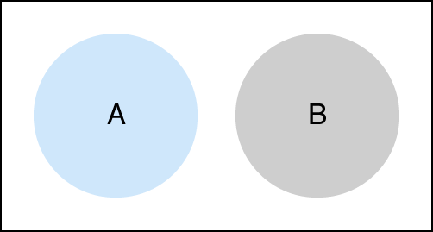
Mutually Exclusive Formula
P(A or B) = P(A) + P(B)

Slide 7
OR
Means you ADD

Slide 8
Example 1:
Find the probability that a girl’s favorite department store is Macy’s or Nordstrom.
Find the probability that a girl’s favorite store is not JC Penny’s.
Macy’s | 0.25
Saks | 0.20
Nordstrom | 0.20
JC Penny’s | 0.10
Bloomingdale’s | 0.25

Slide 9
Sum of Rolling 2 Dice
 | 1 | 2 | 3 | 4 | 5 | 6
1 | 2 | 3 | 4 | 5 | 6 | 7
2 | 3 | 4 | 5 | 6 | 7 | 8
3 | 4 | 5 | 6 | 7 | 8 | 9
4 | 5 | 6 | 7 | 8 | 9 | 10
5 | 6 | 7 | 8 | 9 | 10 | 11
6 | 7 | 8 | 9 | 10 | 11 | 12

Slide 10
Example 2:
When rolling two dice find
P(sum 4 or sum 5)
 | 1 | 2 | 3 | 4 | 5 | 6
1 | 2 | 3 | 4 | 5 | 6 | 7
2 | 3 | 4 | 5 | 6 | 7 | 8
3 | 4 | 5 | 6 | 7 | 8 | 9
4 | 5 | 6 | 7 | 8 | 9 | 10
5 | 6 | 7 | 8 | 9 | 10 | 11
6 | 7 | 8 | 9 | 10 | 11 | 12

Slide 11
Deck of Cards
52 total cards
4 Suits
13 cards in each suit
3 Face cards in each suit

Slide 12
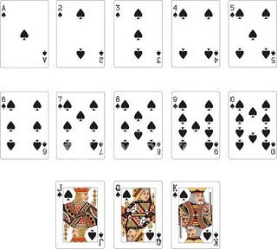
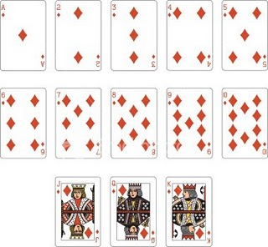
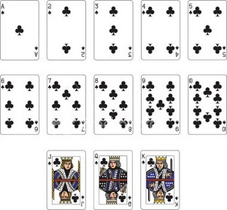
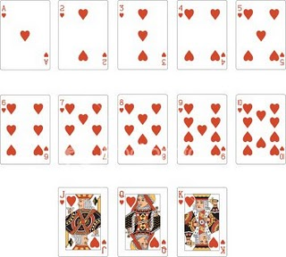

Slide 13
Example 3:
In a deck of cards, find
P(Queen or Ace)

Slide 14
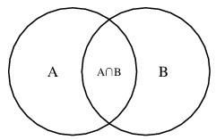
Overlapping Events Formula
P(A or B)
P(A ∪ B) = P(A) + P(B) – P(A ∩ B)

Slide 15
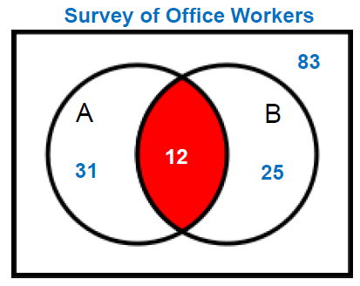
Example 4:
Find the probability that a person will drink both.
A = drink coffee
B = drink soda

Slide 16
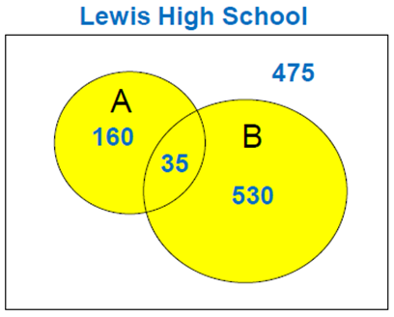
Example 5:
Find the P(A ∪ B)
A = band members
B = club members

Slide 17
Example 6:
In a deck of cards find
P(King or Club)

Slide 18
Example 7:
Find the P(picking a female or a person from Florida).
 | Female | Male
FL | 8 | 4
AL | 6 | 3
GA | 7 | 3

Slide 19
Example 8:
When rolling 2 dice, find P(an even sum or a number greater than 10).
 | 1 | 2 | 3 | 4 | 5 | 6
1 | 2 | 3 | 4 | 5 | 6 | 7
2 | 3 | 4 | 5 | 6 | 7 | 8
3 | 4 | 5 | 6 | 7 | 8 | 9
4 | 5 | 6 | 7 | 8 | 9 | 10
5 | 6 | 7 | 8 | 9 | 10 | 11
6 | 7 | 8 | 9 | 10 | 11 | 12

Slide 20
Example 9: Complementary Events
Find

Slide 21
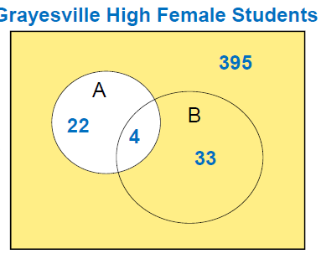
Example 10: Complementary Events
A = plays volleyball
B = plays softball
What is the probability that a female does not play volleyball?

Slide 22
Mutually Exclusive Practice WS
Use your notes to help you out.

Slide 23
Using Venn Diagrams HW WS
Use your notes to help you out.

