Slide 1
14. Law of Sines
The Ambiguous Case (SSA)

Slide 2
The Ambiguous Case (SSA)
Yesterday we saw that two angles and one side determine a unique triangle.
However, if two sides and one opposite angle are given, three possible situations can occur:
(1) no triangle exists,
(2) one triangle exists, or
(3) two distinct triangles may satisfy the conditions.

Slide 3
Finding a missing angle
Remember last unit when we were looking for an angle, we used inverse trig functions (sin⁻¹, cos⁻¹, tan⁻¹)
We will do the same thing in this unit, but instead of getting exact answers off the unit circle, we will use our calculator

Slide 4
Steps for ambiguous case
Set up law of sines and solve for missing angle (use sin⁻¹)
Use the flow chart

Slide 5
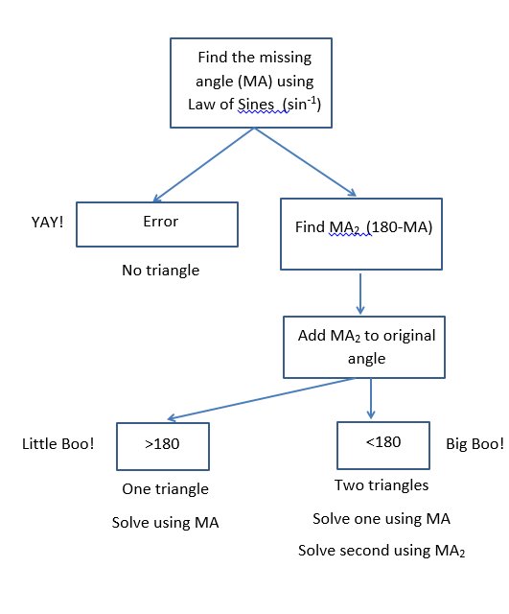
Flowchart for ambiguous case

Slide 6
Example
In triangle ABC, b = 2, c = 8, and B = 120°. Solve the triangle.
B
120°
8
a
C
A?
2

Slide 7
Example
In triangle ABC, c = 10, a = 6, and A = 28°. Solve the triangle.

Slide 8
Example
In triangle ABC, a = 6.5, b = 7.4, and B = 79°. Solve the triangle.

