Slide 1
Warm-up
Graph the following functions
1. y = 3 + 4 sin (4θ – π)
2. y = 2 cos (2/3θ - 2π) - 1

Slide 2
Table of Contents 8. Graphing Sec and Csc

Slide 3
Other Basic Trig Functions
Essential Question – How do you graph sec and csc functions?

Slide 4
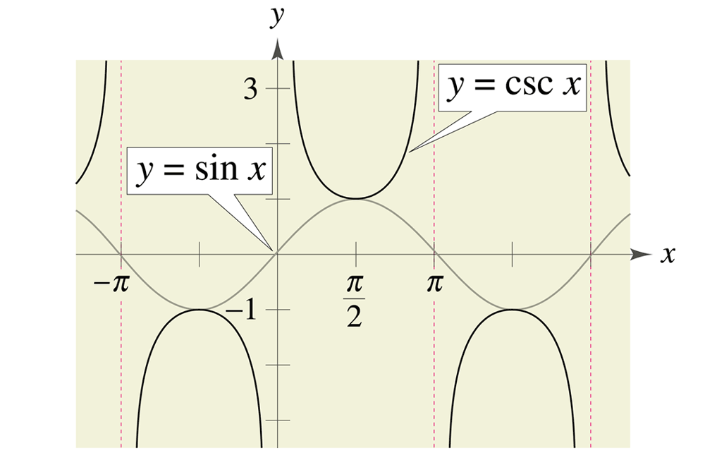
Csc functions
Csc is the reciprocal of sin.
First, graph the sin function.
Put an asymptote at each original y=0 value (3 of them)
Next, flip each section separate by the asymptotes upside down

Slide 5
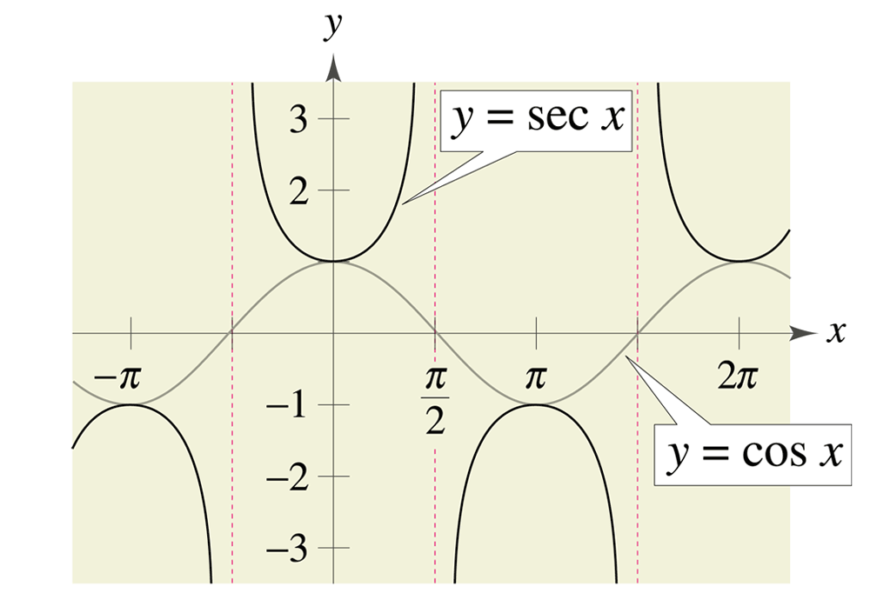
Sec functions
Sec is the reciprocal of cos.
First, graph the cos function.
Then put an asymptote at each original y=0 value (2 of them)
Next, flip each section separated by asymptotes upside down

Slide 6
Graph y = 1 + csc 1/2 θ
First, graph 1 + sin(1/2θ)
Amplitude = 1
Period = 2π/(1/2) = 4π
Intervals = 4π/4 = π
Vertical shift = 1
Flip each section to make it csc

Slide 7
Graph y = -2 + sec(θ-π)
First, graph -2 + cos(θ-π)
Amplitude = 1
Period = 2π
Intervals = 2π/4 = π/2
Vertical shift = -2
Horizontal shift = π
Flip each section to make it sec

